Slide 1

Students Performance in Exams Analysis using Machine Learning
Contributors:
MR KINGSLEY JOEL
MISS ELIZABETH EPHRAIM
MR AYODEJI MATHEW DEDE
MR DAMILARE SAMUEL

Slide 2
Abstract
Examination has been an important part of the education system for ages. There’re a number of existing studies pertaining to the performances of student’s in exams. Factors such as parents’ level of education, socio-economic status, interest in a subject, punctuality in class, regular studying etc. have the potential to improve the performance of high school students in exams. However, the aim of this research is to analyze how these factors: Parents’ background, Test preparation, Lunch, Gender and Race affect the performance of students in exams. Secondary data was collected in respect to strata of various students who shared similar characteristics and sat for same exams. Both descriptive statistics, linear regression and correlation statistics, a vast of raw data were used to analyze the data collected. The result of the findings disarmed the belief that parent’s backgrounds is a contributing factor to students’ performance but that students who leveraged on the Test preparation option and had good lunch had a higher test score in the end.

Slide 3
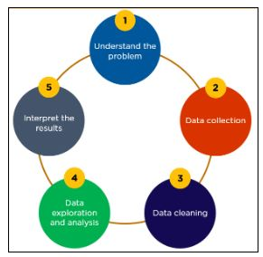
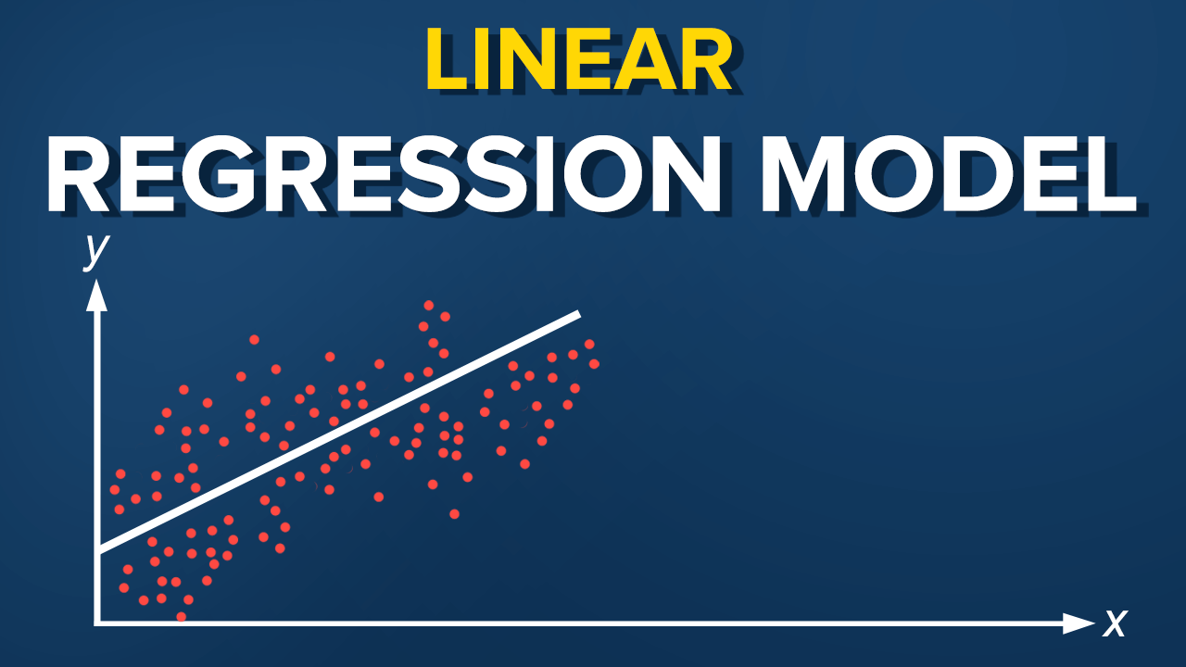
Introduction
Data analysis Student performance
Machine learning Regression model
Fig. 1: Schematic Description

Slide 4
Selected Literature
Oyedeji et al. (2020) in their study reported that linear regression for supervised learning produced the most preferable model.
Kotaiah and Fazal (2019) examined the significance of data analysis in the studying students’ performance in citadel of learning.
The present project provides answers to the following related research questions:
What are the major factors influencing the test scores of students in exams?
How can students’ performance in exams be improved?
What is the effectiveness of the lunch and test preparation in aiding students’ performance?

Slide 5
Objective
collect data;
classify data attributes into dependent and independent variables;
analyze the data;
predict the data using a reliable method called linear regression model; and
visualize the data to see how pertinent factors such as lunch and test preparation affect students performance in exams.

Slide 6
Methodology
TARGETED POPULATION
This study was carried out among 1002 students with different characteristics who sat for the same examination but with different personal, social and economic factors.
HYPOTHESIS:
The aforementioned attributes that influence student performance such as gender, class attendance, demographic, parental background and economy, test preparation and adequate lunch are categorized into dependent and independent variables. Factors like test preparation and lunch are chosen as dependent variables because they directly affect students’ performance while parents’ background, sex, ethnicity and economy are categorized as independent variables because they have no effects on students’ performance in exams.

Slide 7
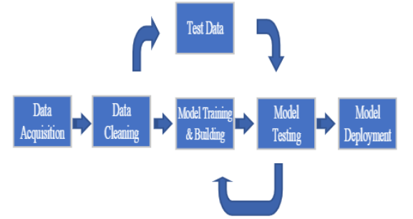
Methodology contin…
RESEARCH METHOD
We approach the obtained data by using quantitative simulation research methods which will be conducted as demonstrated by the schematic diagram in Fig. 1. The collected data are made to pass through visualization and clustering procedures. In between, and before the classification models’ evaluation phase, the datasets will pass through a pre-processing (e.g. cleansing) stage to make it ready for the analysis phase. Based on the nature of the dataset being analyzed (independent variables and dependent variables), the suitable statistical tools used in this study is linear regression model. Specifically, regression analysis is engaged because the dependent variables are considered to be continuous.
Fig. 2: Methodological Framework

Slide 8
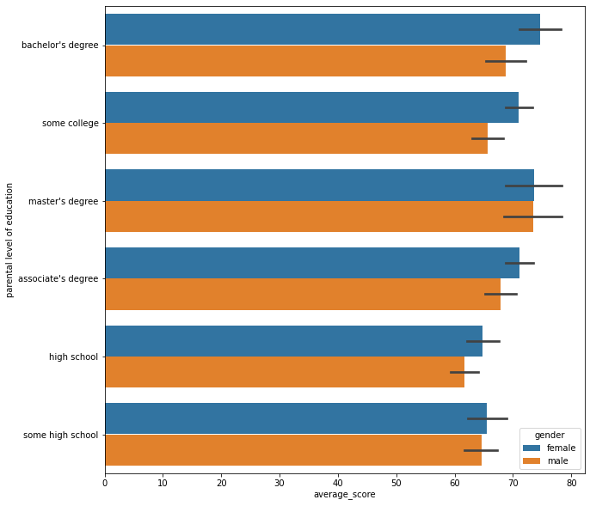
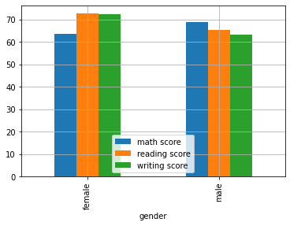
Data Visualization and Analysis

Slide 9
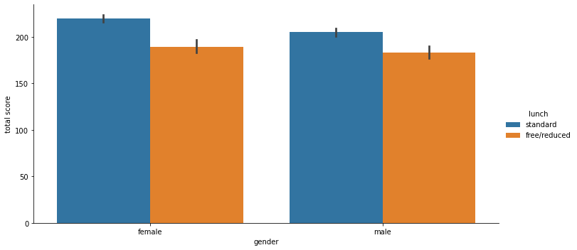
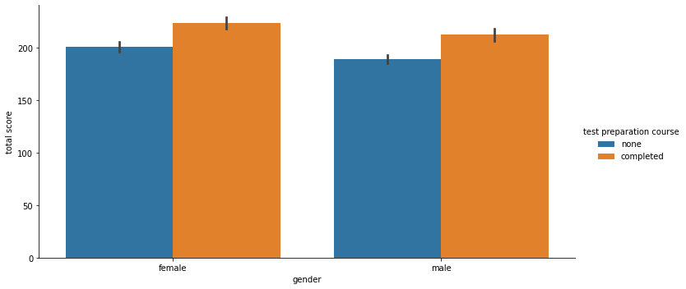
Data Visualization and Analysis

Slide 10
Conclusion
The goal of the study is to analyze various machine learning algorithms in the student results in the performance prediction system. The prediction algorithm is designed using Python language. Major findings from the present project are listed as
The test preparation course as well as adequate standard lunch, positively affects the performance of students in exams;
Students who take the preparation course and eat standard lunch will always perform well in exams, so this should be mandatory; and
The Effectiveness of Lunch and Test preparation course on students performance in exams is 100% positive.

Slide 11
Recommendation
The study recommends that
students should put in serious effort in preparing for test; and
students should be provided with good and nutritious lunch during examination to improve their memory capacity and to keep them strong for examinations.

Slide 12
References
Kotaiah, B. and Fazal, M. N. (2019). Analysis of Student Result using Machine Learning in Python. Turkish Journal of Computer and Mathematics Education, 10(1), 467-473.
Oyedeji, A., Salami, A., Folorunsho, O. and Abolade, O. (2020). Analysis and Prediction of Student Academic Performance Using Machine Learning. Journal of Information Technology and Computer Engineering, 4(01), 10-15.

Slide 13
THANK YOU FOR LISTENING

